Slide 1
JMP Add-in with R script
05.22.2019
John Solis
Manager
TECH | TELeMetrics Productivity Solutions

Slide 2
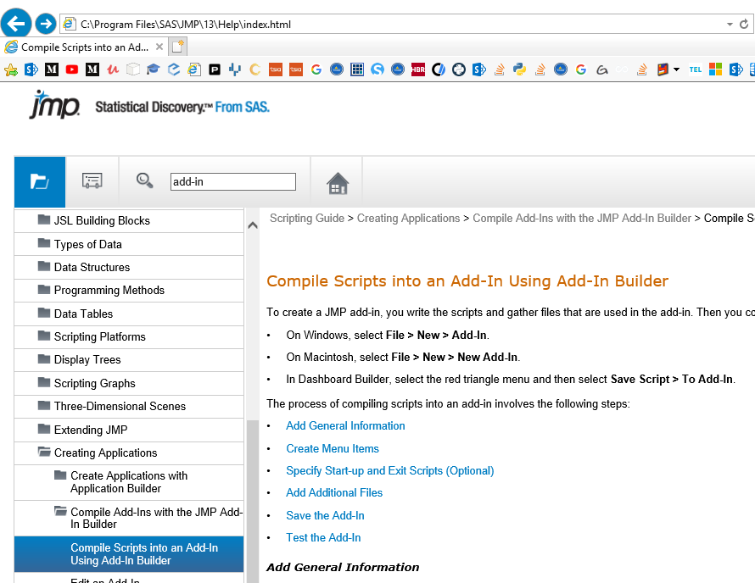
JMP add-in info
file:///C:/Program%20Files/SAS/JMP/13/Help/index.html#page/jmp%2FJSG_BuildingApps_12.html

Slide 3
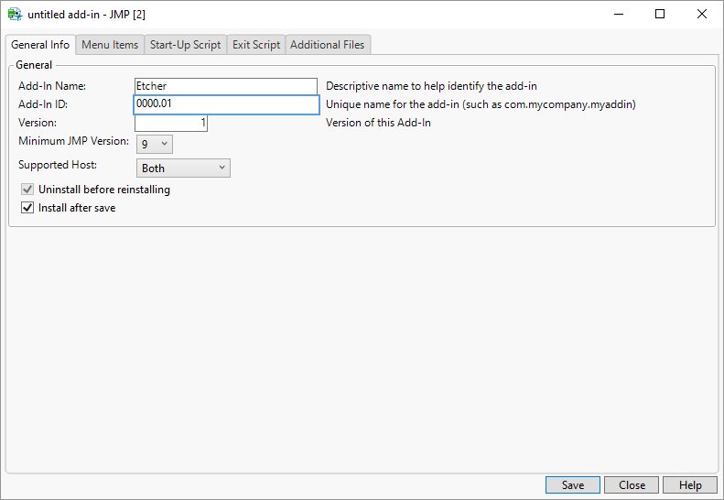
New JMP add-in creation

Slide 4
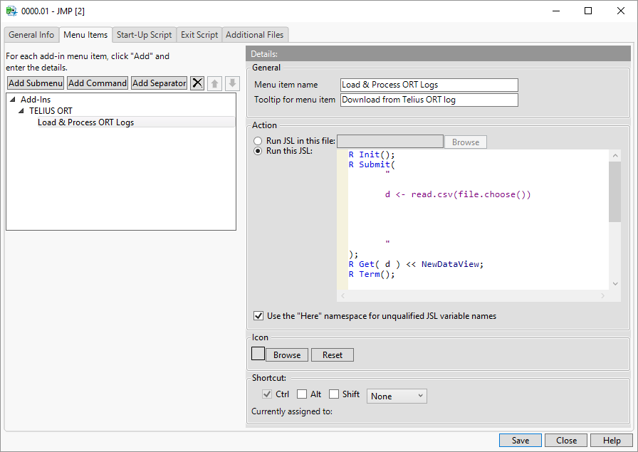
New JMP add-in creation
Add Submenu
Add Command
Save (it will install into your JMP)
Copy & Paste below code:
R Init();
R Submit(
"
d <- read.csv(file.choose())
"
);
R Get( d ) << NewDataView;
R Term();
R code goes here
Your code

Slide 5
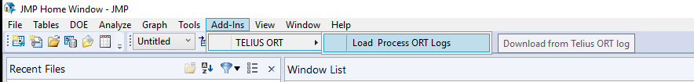
New JMP add-in creation
From JMP open add-in file to install

Slide 6
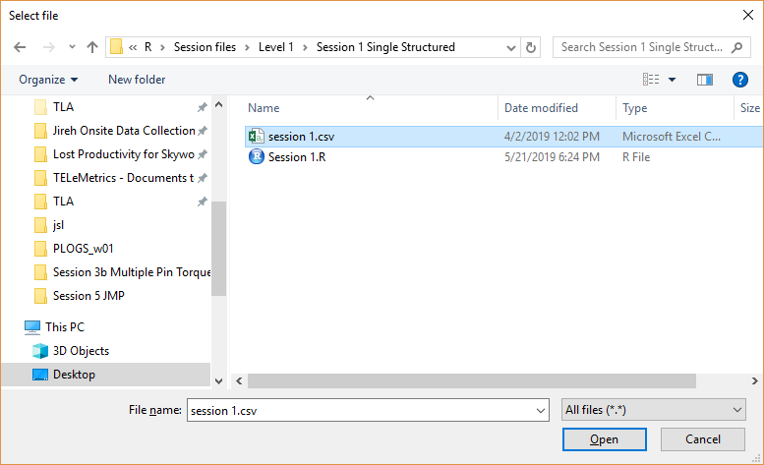
JMP add-in usage
Click here to lauch

Slide 7
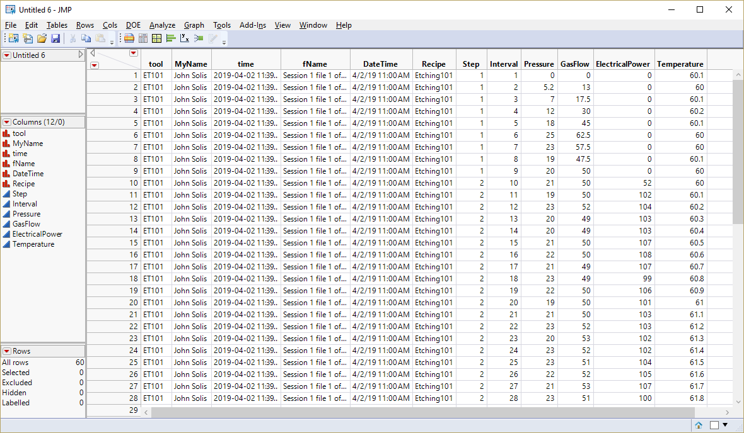
JMP add-in usage

